Slide 1
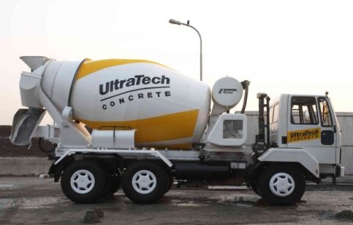
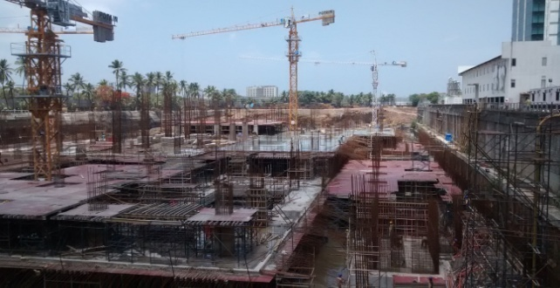
MASS CONCRETE POURS

Slide 2
Mass concrete - Definitions
Mass concrete is “any volume of concrete with dimensions large enough to
require that measures be taken to cope with generation of heat from hydration
of the cement and attendant volume change to minimize cracking.” – ACI 207.1R-96
The design of mass concrete structures is generally based on durability,
economy, and thermal action, with strength often being a secondary concern.
The only difference between mass concrete and other concrete works is the Thermal Behavior.
As a rule of thumb, any concrete element cast against an adjacent element of the same thickness or greater, and which achieves a temperature rise in excess of about 20 °C, has a significant risk of early thermal cracking if the length of the joint exceeds about 5m.

Slide 3
When and Why cracks can occur.
There are numerous factors which influence the early thermal behavior of concrete
increasing Portland cement content
increasing placing temperature
increasing pour thickness
increasing restraint.

Slide 4
DEF
Delayed Ettringite Formation (DEF)*
Ettringite , C₆AS₃H₃₂,is a normal product of the early stages of cement hydration under ambient conditions but does not form in concrete where the temperature (either as a result of applied heat or from heat evolved internally from the hydration process) exceeds about 70°C. Such temperatures may also destroy any ettringite already present.
Ettringite will, however, slowly form after cooling provided sufficient water is available. Ettringite formation leads to an increase in the total solid volume of the cement and can be an expansive process.
If there is insufficient space within the paste structure for ettringite to form, internal stress, expansion and cracking may occur.

Slide 5
Cement Hydration Generates Heat
Cement
Water
Heat
Chemical reaction of cement with water (cement hydration) is a exothermic process.
Typically a temperature rise at core is about 1.0-1.2ºC per 10 kilogram of cement.
Peak Temp = Fresh Concrete Temp + Temperature rise from Cement Hydration
Cement content is 400 kg, fresh concrete temperature at pouring is 32ºC
32ºC + 400/10 x 1.1ºC = 76ºC

Slide 6
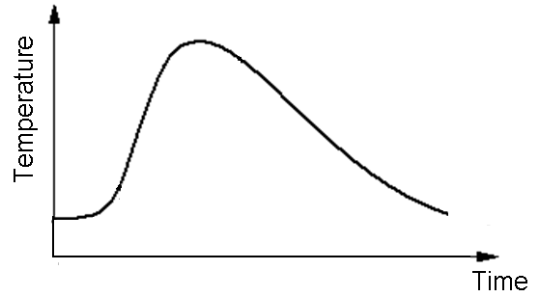
Thermal evolution over time in mass concrete
Peak T
Placing T
Heating
Cooling
Heat generated by cement hydration = f (cement type and content)
Dissipation of heat to the environment = f (dimensions, construction process, ambient conditions)

Slide 7
Mix Design: SCMs
No. Cement Type Heat of Hydration
at 100% Hydration
(cal/g)
1 Type I Cement 114
2 Type I Cement + 15% Class C Fly Ash 113
3 Type I Cement + 25% Class C Fly Ash 112
4 Type I Cement + 35% Class C Fly Ash 111
5 Type I Cement + 45% Class C Fly Ash 110
6 Type I Cement + 15% Class F Fly Ash 106
7 Type I Cement + 25% Class F Fly Ash 101
8 Type I Cement + 35% Class F Fly Ash 95
9 Type I Cement + 45% Class F Fly Ash 88
10 Type I Cement + 30% GGBFS 113
11 Type I Cement + 50% GGBFS 112
ACI Materials Journal, “Heat of Hydration Models for Cementitious Materials”, Title no. 102-M04

Slide 8
Two Key Criteria for compliance
Criteria 1(Peak Temperature)
Maximum peak temperature not exceeding 70°C.
Some specifications may be more relaxed depending on the cement type used and prove of evidence that specified peak temperature is not reached. Mock-up are usually done to reflect casting conditions.
Some specifications can be more stringent with a much lower temperature down to 60°C depending on the structural use.
Criteria 2(Temperature Differential)
Temperature differential between two points is not more than 20°C. Some specifications may specify a temperature gradient of 20°C.

Slide 9
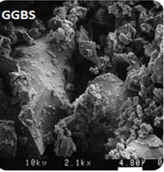
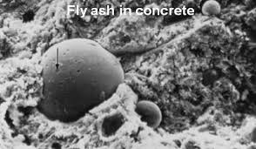
Possible solutions to comply with Criteria 1
Criteria 1(Peak Temperature) :
Maximum peak temperature not exceeding 70°C.
Control temperature of raw materials to ensure initial
concrete temperature is as low as possible.)
Cement fineness
Use of low heat cement. (PFA or GGBS)
Better mix design with lower cement content or bigger size aggregates.
Admixtures, silica fume
Cooling systems (liquid nitrogen, piping systems).

Slide 10
Evaluation of thermal stresses
Temperature Monitoring Report of Mockup M40
Key Observations:- 1) Peak Temperature : 67.0°C at Cube Center (Core)
Time duration of Peak Temperature : After 62.00 Hrs from Batching Time.
Maximum Thermal Gradient : 5.7°C (Temp Diff between Core & Bottom Corner)

Slide 11
Mass Concrete Projects
Item | Details
Project | Construction of High rise Building, Mumbai Central. Mumbai
Client | M/s. Nathani Heights
Project Management Consultant | M/s. Fairwood Pvt.Ltd.
Structural Consultant | M/s. Thornton Tomasetti
Grade of Concrete | M40 – Raft Concrete and M80 – Shear Column
Fresh concrete properties | Flow of concrete should not be less than 550 mm
 | For M80 grade of concrete Height of Pumping up to 150 m
 | Placing temperature of concrete should not be more than 28 ° C.
Harden concrete properties | a) 80 Mpa at 90 days
 | b) Core temperature should be less than 75 C
 | c) Differential temp. should be less than 20 C
 | d) Flyash should not be more than 35 % and slag should not be more than 70%

Slide 12
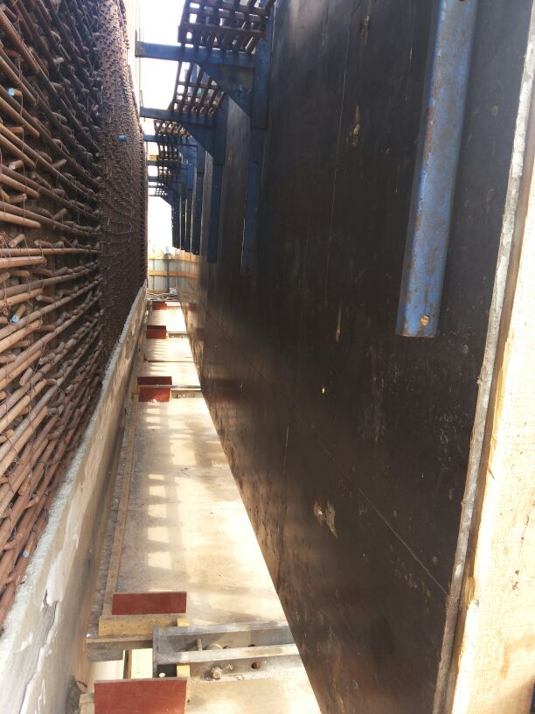
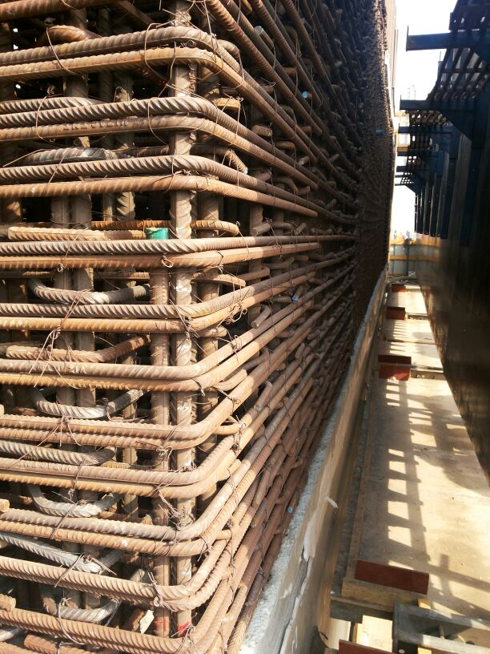
Mass Concrete Projects- Nathani Heights
UltraTech “Hypercon “ quadruple blend concrete designed with optimum proportion of raw materials is supplied for M80
We have supplied more than 2500 cum of UltraTech M80 Hypercon with 4.4 standard deviation
Compressive Strength 95 MPa @ 90 days

Slide 13
Mass Concrete Projects- DAICEC- RIL
Item | Details
Project | Dhirubhai Ambani International Convention and Exhibition Centre
Client | M/s. Reliance Industries
Project Management Consultant | M/s. Samsung
Contractor | L&T Construction
Grade of Concrete | M40-M50-M70
Fresh concrete properties | Flow of concrete should not be less than 500 mm
 | Concrete placing temperature should not exceed 30 deg c
Hardened concrete properties | GGBS concrete with 56 days strength criteria
 | Core temperature should be less than 72 C

Slide 14
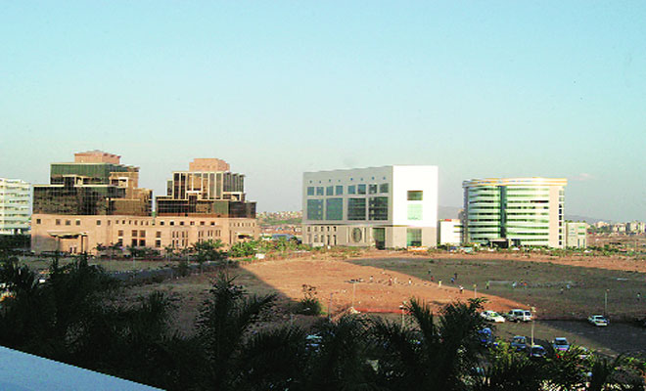
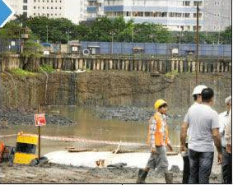
Mass Concrete Projects- DAICEC- RIL
UltraTech Thermocon is designed using 66% SCM to control risk of thermal stresses arising in mass concrete foundations

Slide 15
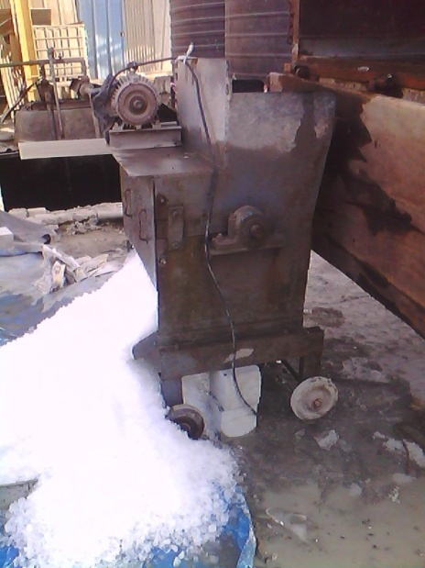
Raw Materials temperature & its effect on fresh concrete temperature
*from Neville, w/c 0.5 & agg/c 5.6
In terms of Efficiency:
Cooling of Aggregates.
Use of Chilled Water or Ice.
Use of Cool Cement.

Slide 16
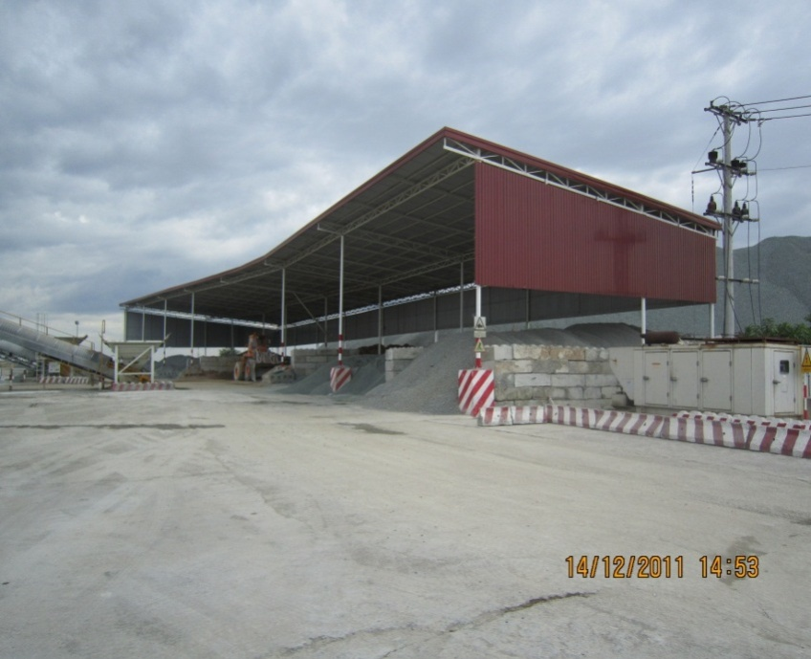
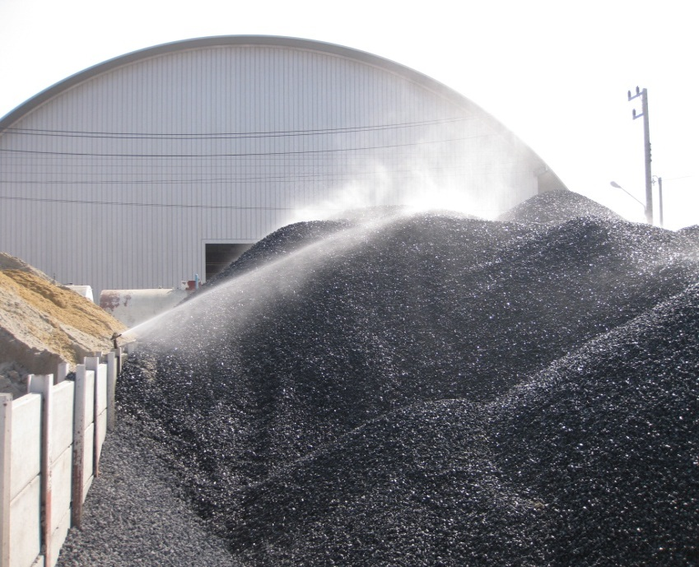
Ways to cool aggregates
Roof over aggregates will shelter heat from the sun, fine water mist spray cools aggregates when water evaporates
Air condition the aggregate stockpile area ?

Slide 17
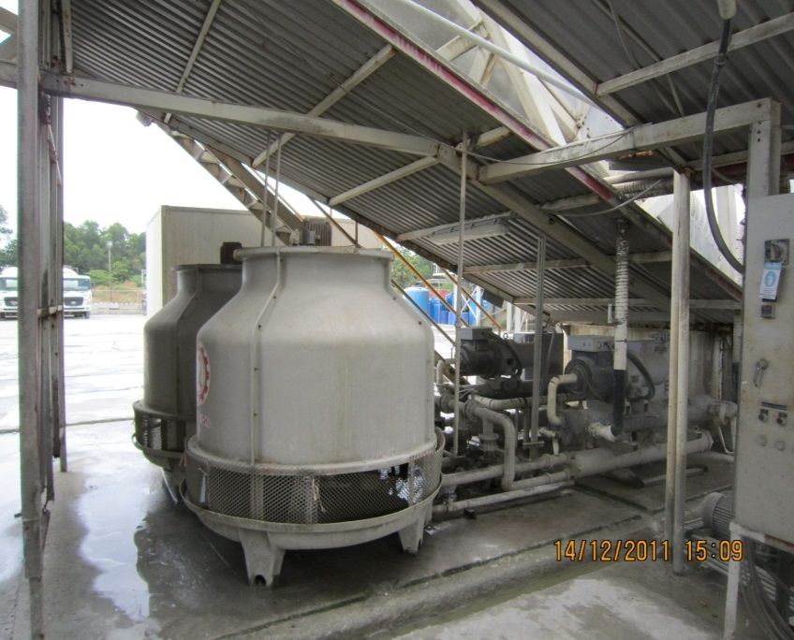
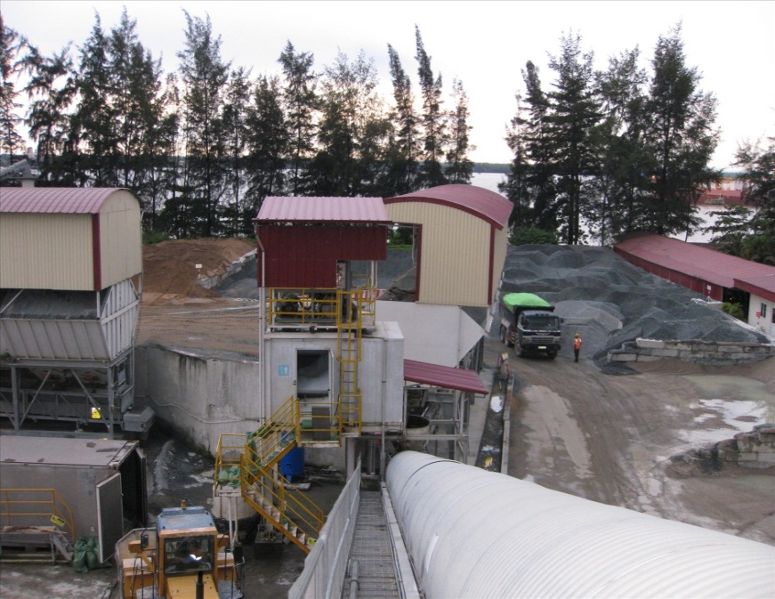
Chill Water System & Ice Factory
Chiller Water System
Ice Factory above conveyor belt

Slide 18
How to estimate the fresh concrete temperature?
Concrete Temperature* = 0.75(T_{c}M_{c} + T_{a}M_{a}) + 4.18T_{w}M_{w} - 334M_{i}
0.75(M_{c} + M_{a}) + 4.18(M_{w} + M_{i})
Where:
T = Temperature °C
M = Mass in kg/m³
c = cement
a = aggregates
w = water
i = ice

Slide 19
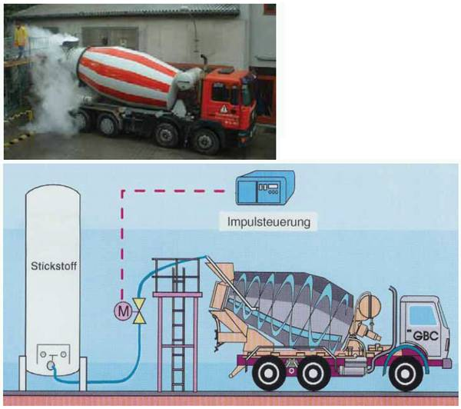
Injection of liquid nitrogen to cool concrete
Cost and safety issues need to be considered before using such system
Gajda

Slide 20
Possible solutions to comply with Criteria 2
Criteria 2 (Temperature Differential):
Temperature differential between two points is not more than 20°C.
Proper insulation.
Placement by layering concrete of different initial concrete temperature.
Placement by layering concrete of different cement content.
Piping cold water to cool concrete.

Slide 21
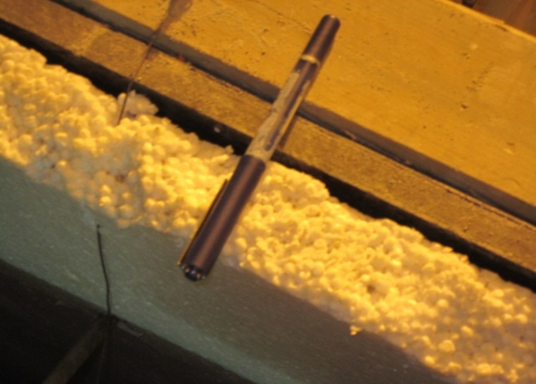
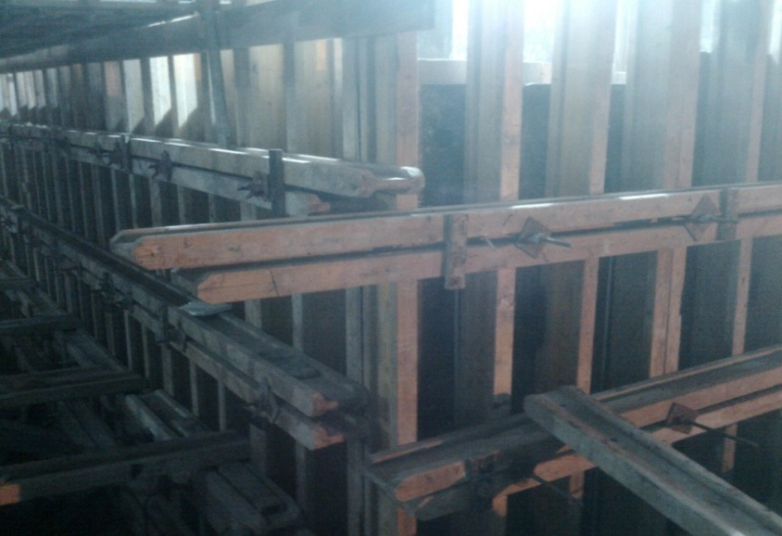
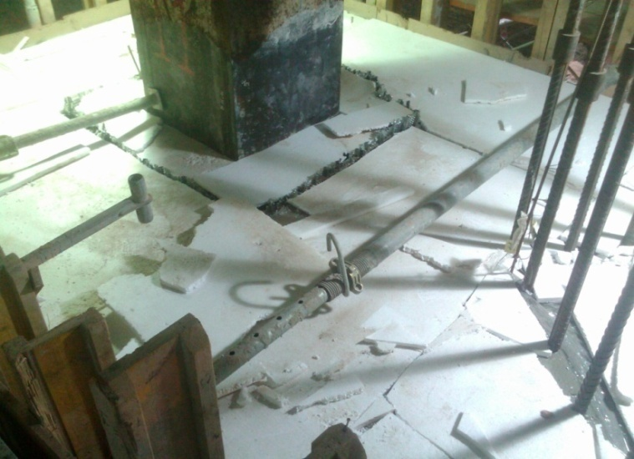
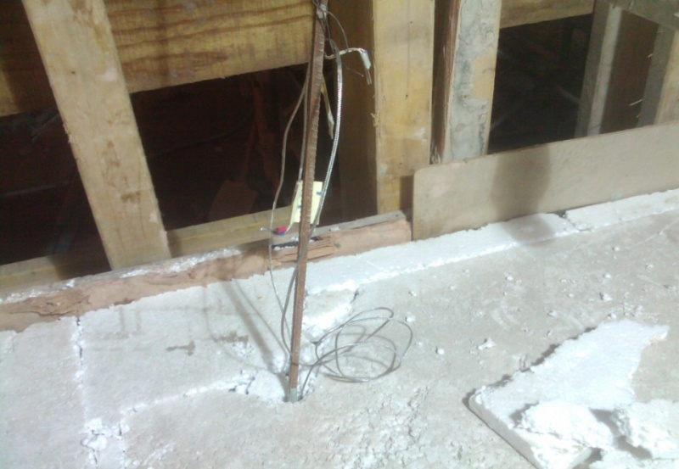
Insulation to prevent rapid heat loss at surface
24/07/2019

Slide 22
Layering method and thermocouples installation of mockup
Using the layering method is the way to create the layers with different temperature.
The bottom layer and the top layer is 0.6m.
The middle layer is 1.2m and its volume is 50% of the total casting volume.
The temperature at each layer:
At the bottom layer: 31°C – 32°C
At the middle layer: 26°C – 28°C (as cool as possible)
At the top layer: 31°C – 32°C
The layout of thermocouples

Slide 23
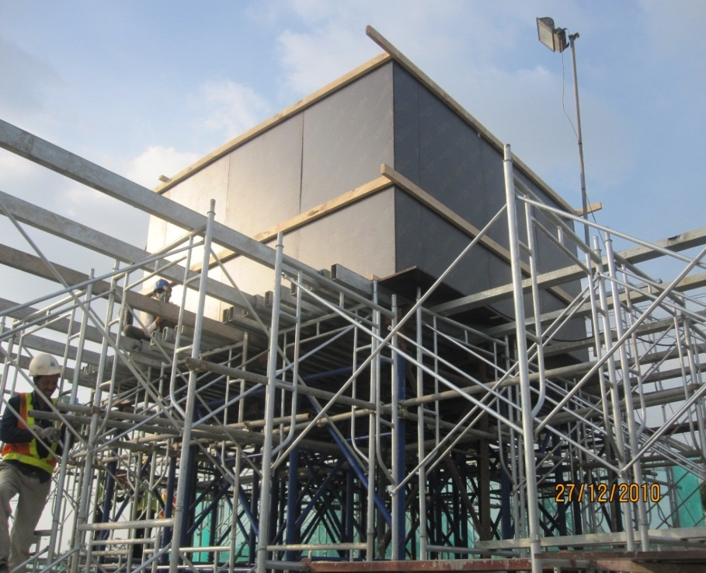
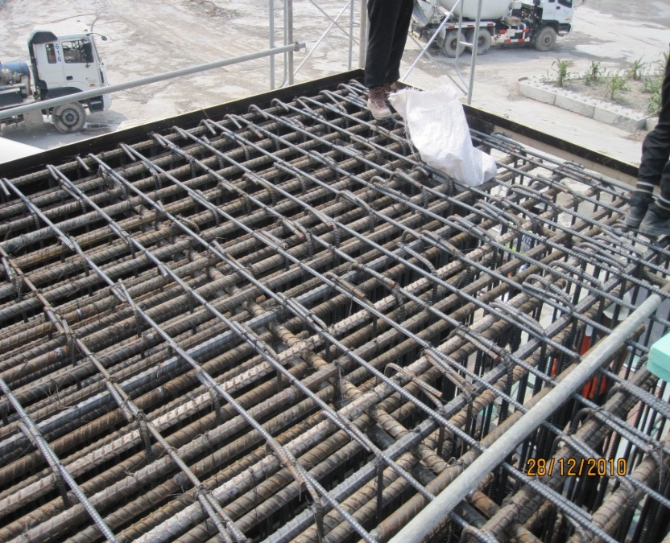
Example of a Mock up
Mock up is 4 x 4 x2.5 m and is 3.5 m above ground.
Concrete volume is 40 m3.
Dead load excluding steel is almost 100 ton.
Large area needed and also issue of removal after monitoring

Slide 24
Criteria 3
Your ability to handle concrete with supply rate required and organize team at site

Slide 25
Planning Check list
Understand the Requirements
Why/What
Check
This will give you estimate of the raw materials required.
1
What is the total volume required ?
If supplied over a few plants, do the necessary allocation with excess to
prepare for the what ifs?
Give advance notice to your suppliers on the impending requirements.
Slump check requirement will give you plan for manpower requirements. It is
usually the bottleneck with high rate of casting.
May need more than one slump check point to speed up the process.
Sampling plan for test samples will give you plan for manpower and also the
2
What is the specified sampling plan for
number pf molds needed.
checking slump and making samples?
Important to have adequate manpower for making test samples as tired
hands will make poor samples.
Always bring extra molds as they will be some that are out of shape.
Where sampling rate is too high, try to discuss with Consultant to reduce,
back up with relevent standards.
Important to understand the rate of supply at different stages as it allow you
3
What is the rate of supply at different stage of
to better plan your scheduling and truck strength.
casting
It also prevents unnecessasy waiting time at site that can also affect the
concrete quality.
Understand pump requirements and also pipe lines requred. Gauge the time
needed for installation for better preparation.
4
Pump requirements
Number of standby pumps needed. If pumps are provided by Customer,
raise the need to have standby pumps. It also shows your concern for a
successful pour.

Slide 26
Planning Check-list
Route and Site Condition
Why/What
Whether supply from one or many plants, important to understand the
possible obstructions that can impede the supply and how to avoid.
1
Check the routes to the site
Identify areas trucks enroute can park and wait incase of what ifs.
Need to know any regulation hours and weight constraint that will prevent
supply thus need to plan alternative route.
2
Check the distances from plant to site
This will allow you to plan on the number of trucks needed for each plant.
Identify out any areas of concern on safety. Involve Site Safety Officer and
Customer.
Identify the entry and exit to the site. Always plan for a one direction flow
where possible. Work with Customer.
Identify truck waiting area. Work with Customer.
Identify area for slump check and test sample area. Areas should be flat and
also sheltered as it will be a very long day and need to provide a comfortable
3
Survey the site conditions
area for both Inspectors and Quality Testers. Work with Customer.
Identify truck washing area and also discharge from drum washing. Work
with Customer.
Truck washing can also be a bottleneck if insufficient staff to do washing.
Identify areas to locate pumps if providing pumps. Work with Customer.
Clear understand of where to lay pipelines and when to start. Work with
Customer.
This provide for better information flow to brief your pump and truck drivers.
4
Have clear maps of routes to site and also site
Clearly identify location of pumps and also give it a identification, example
plan.
PUMP 1, PUMP 2, etc. Clear identify on Pump at site.
This will provide for ease of driver to find Pump.

Slide 27
Planning Check-list
Site Management
Why/What
This will provide for better flow of instructions and information.
1
Establish single point of contact between
Provide list of contact numbers and their positions.
Contractor and your Site Coordinator
Be prepared for the what ifs and if possible discuss with Customer prior to
casting.
2
First two hours of supply
Strong management at site at 1st two hours is critical to iron out any issues
for a smooth delivery. Provide constant feedback to Customer Service.
Plant Preparation
Why/What
Identify the plants to supply and standby plants
Make your decision base on both distance and contribution. If it’s the first big
1
based on distance and Contribution
pour at the site, service level is of main importance as usually there will be
consideration
many eyes (Owner, Consultant, Contractor) watching the pour.
2
Do maintenance and checks on plant
Failure in equipment is always a cause for disruption in supply ending in
equipments.
Customer disatisfaction.
Brief all staff on importance of pour and also
Worst scenerio is not getting the slump wrong as by the time there any
3
get the initial slump at plant correct. Carry out
adjustment can be done you will likely have 20 trucks on the road.
trials based on travelling time if necessary.
Understand different weather condition can
This also affect on your initial slump at plant.
4
affect slump loss rate.
Ensure all Batchers are familiar with the properties of the mix.
5
First two hours of supply
Strong management at plant at 1st two hours is critical to iron out any issues
for a smooth delivery.

Slide 28
Planning Check-list
Mix Design
Why/What
1
Understand the sequence of casting
Casting sequence gives you indication on the slump retention and setting
time requirements.
Ensure mix design is same for all plants of
Bad image to get truck rejected due to difference in Mix Design.
2
supply and same as trial mix submission.
Ensure Customer is OK for supply from Plants that have not done trial
mixes. Some Consultants do not agree for supply.
Customer Service
Why/What
1
Manage the Orders taken for supply to other
This is to prevent over stretching the capacity and thus poor service level to
sites on day of the Big Pour.
Customers.
2
Be ready for SAP breakdown.
Both Plant and Customer Service need to exactly the procedure so that
there is no disruption to supply due to "
not sure what to do
"
Food & Refreshments
Why/What
Plan for the food and refreshments for both at
In big pour, continuity is important and you will need to ensure that all your
1
Plant and at Site for all staff inclusive of the
staff are well taken care off. Example you will not want your drivers to all take
Drivers.
a one hour lunch break.

Slide 29
Planning Check-list

