Slide 1
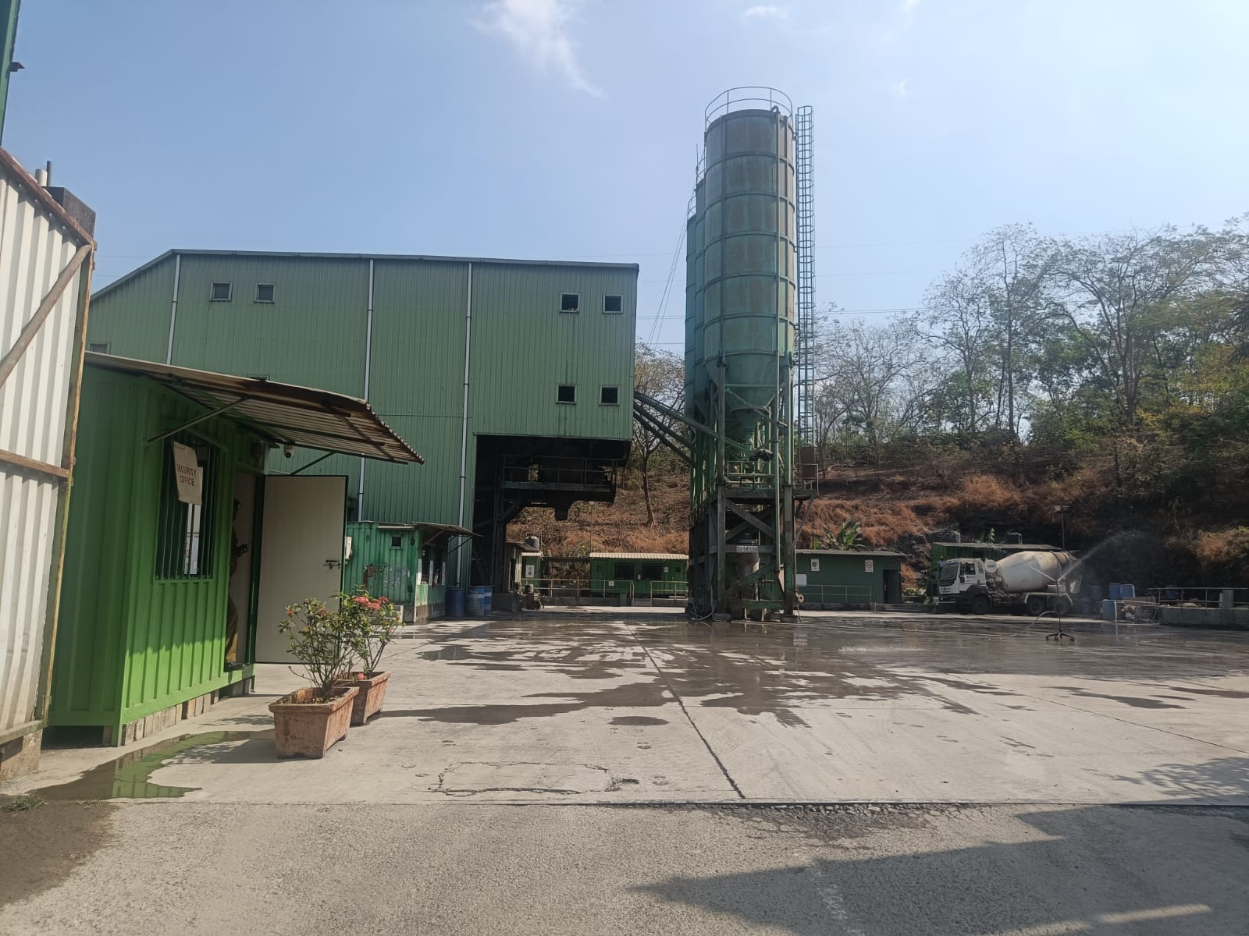
A Presentation on
Good Practices Implemented in Godrej & Boyce RMC Plants

Slide 2
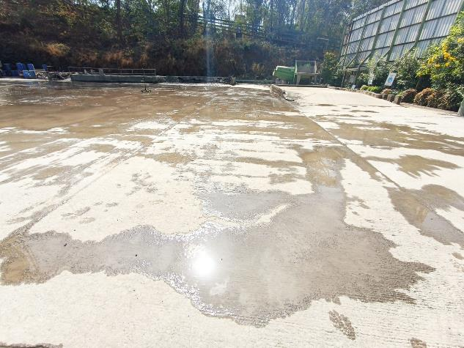
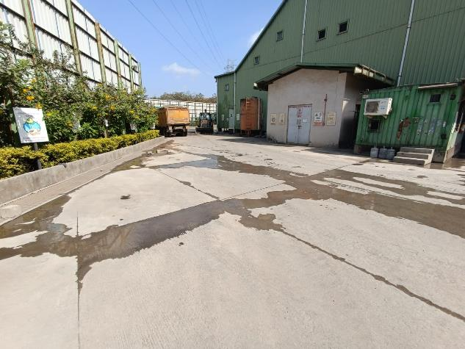
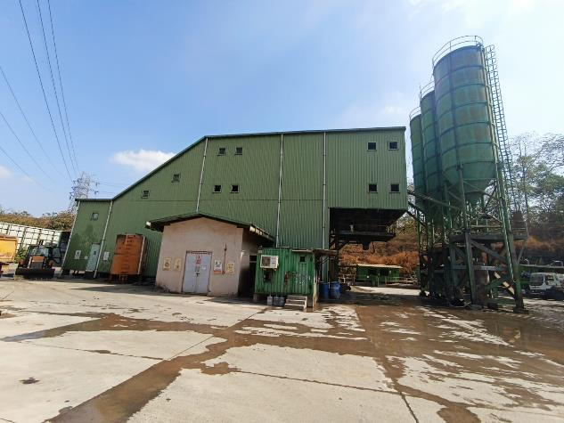
Concreted Internal Roads
All internal roads/ vehicular movement area is concreted & maintained well to avoid dust emission.

Slide 3
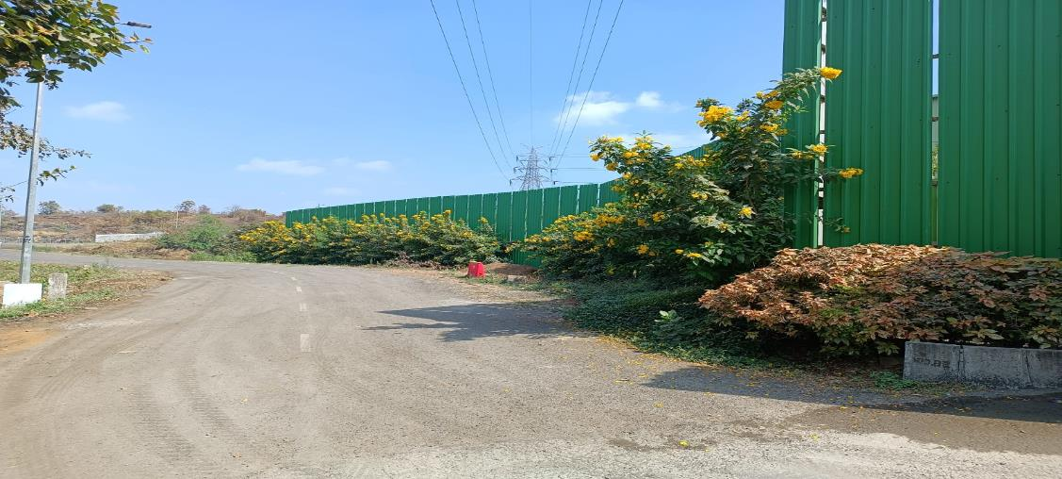
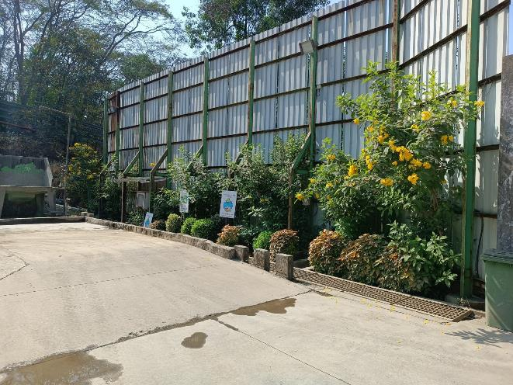
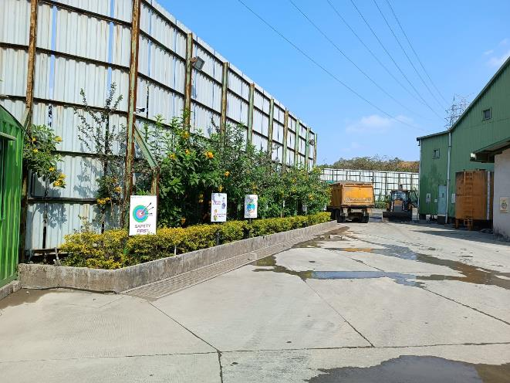
Barricading around Plant Periphery
Barricading of tin sheets of approx. height 20 ft. around the plant periphery.

Slide 4
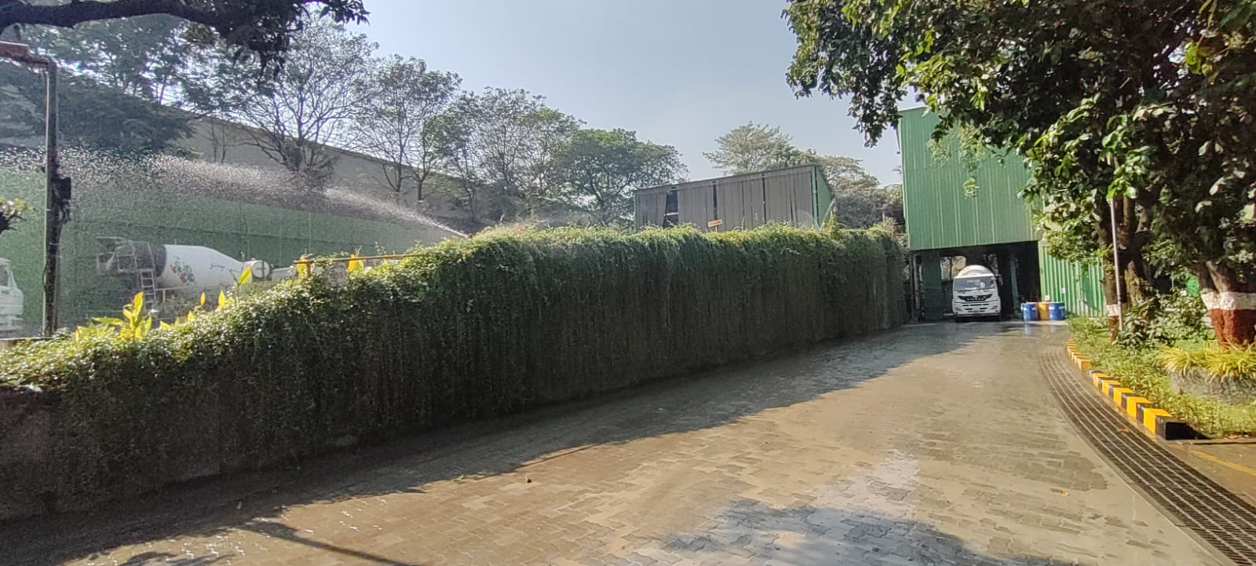
Water Sprinkling System
Fixed & Portable water Sprinklers have been provided to avoid dust emission.

Slide 5
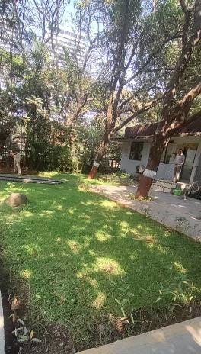
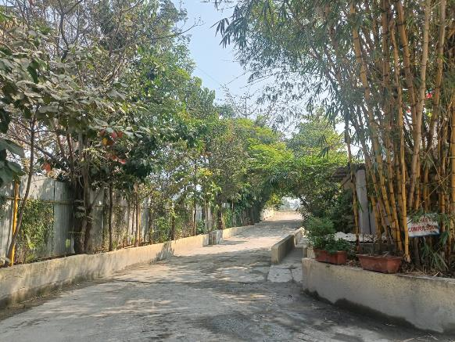
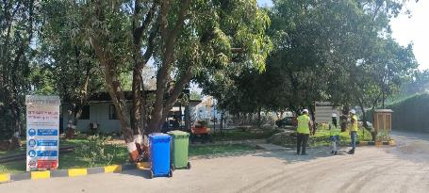
Greenbelt Development
Provision of Greenbelt to attenuate noise & dust pollution.

Slide 6
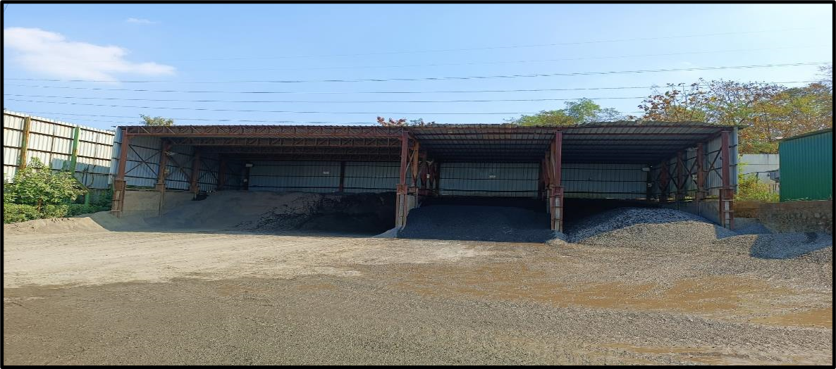
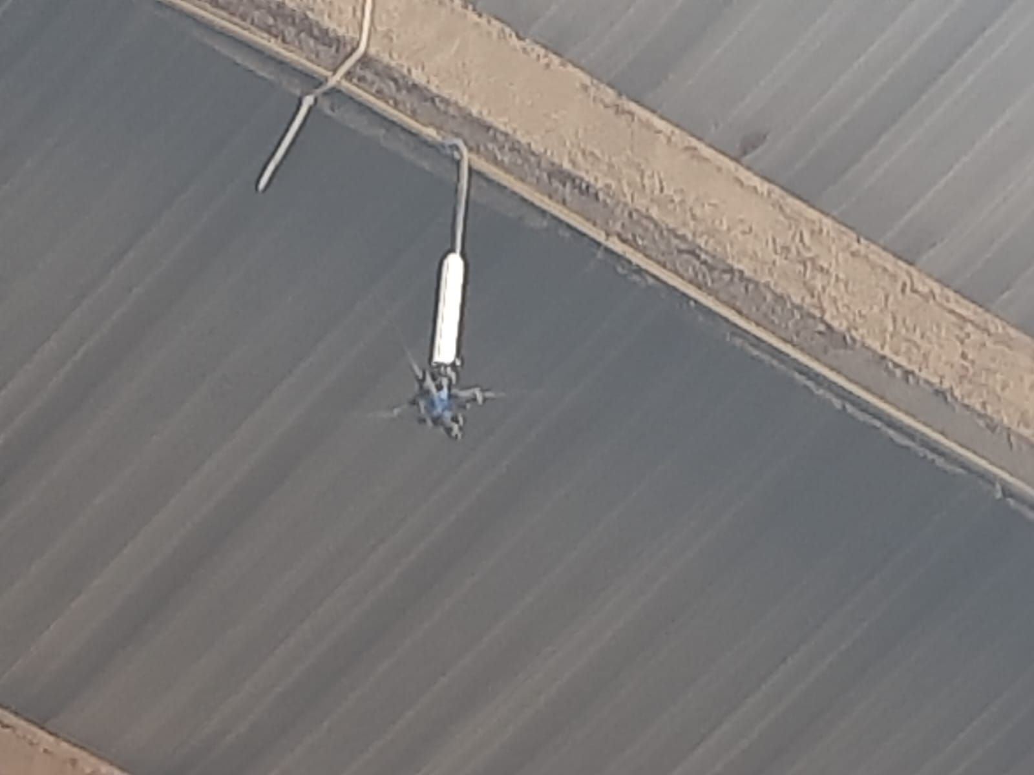
Material Storage Shed
Covered Material Storage Shed along with Provision of Fixed Water Sprinklers in it to avoid dust emission.

Slide 7
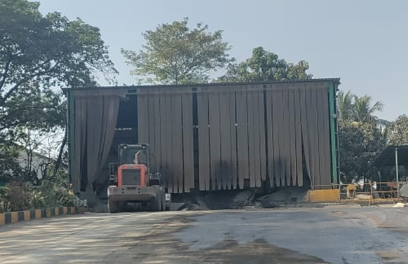
Material Loading Point
Material loading point covered properly from all 3 sides.
Front side is covered with thick plastic curtains to arrest dust pollution.

Slide 8
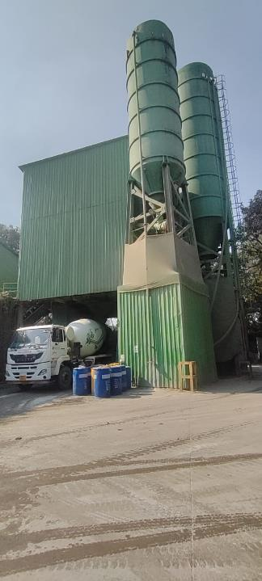
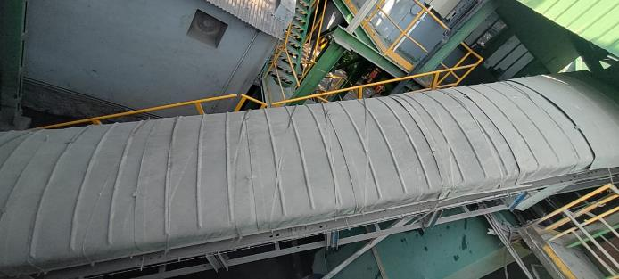
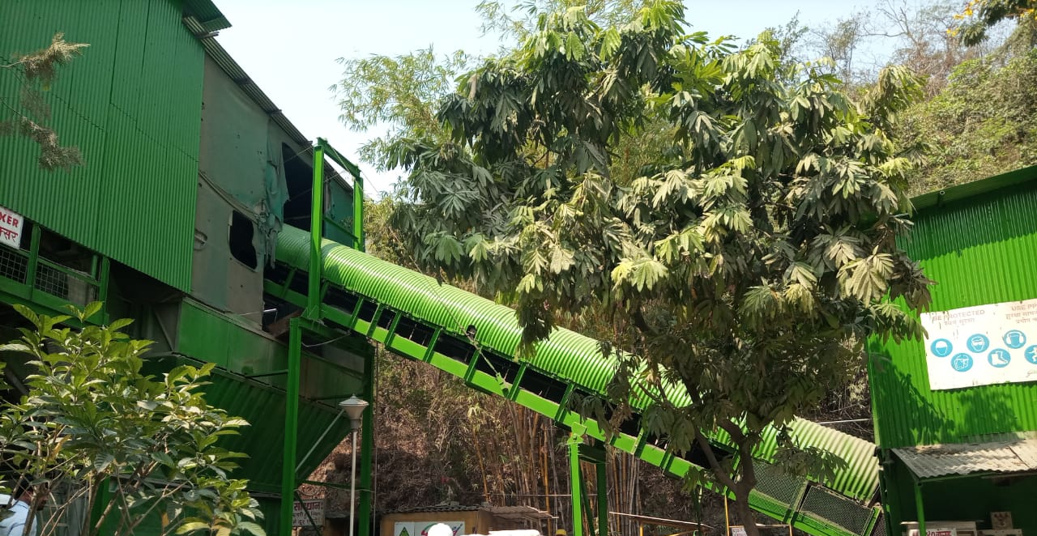
Material Transfer Point
Material transfer points like conveyor belt and mixer area are covered with GI sheets to control fugitive emission during material transfer.

Slide 9
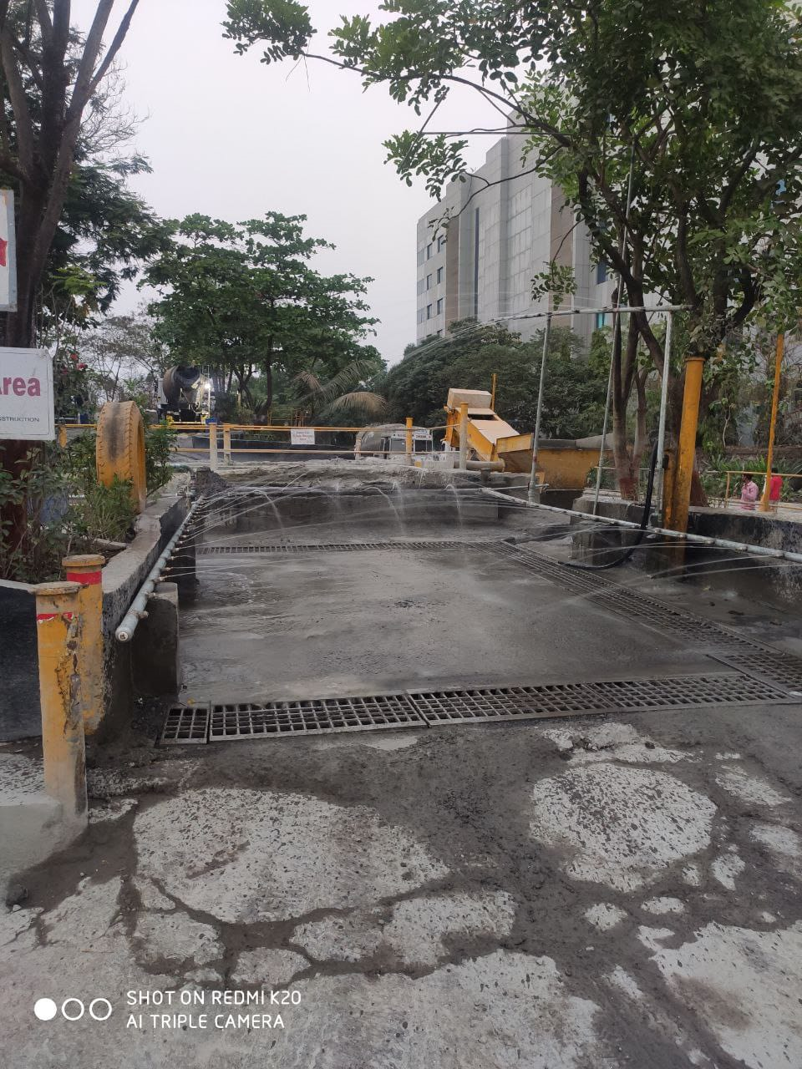
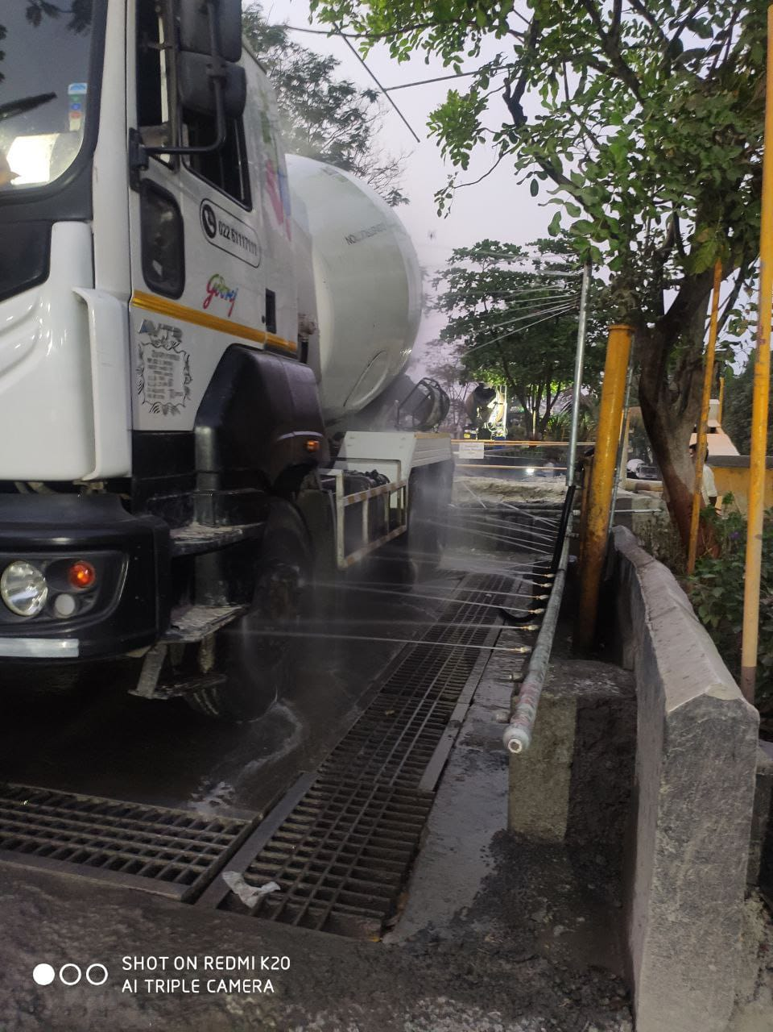
Tyre Washing Area
Tyre Washing System has been provided so that the vehicle could not carry dust along with it outside the plant premises.

Slide 10
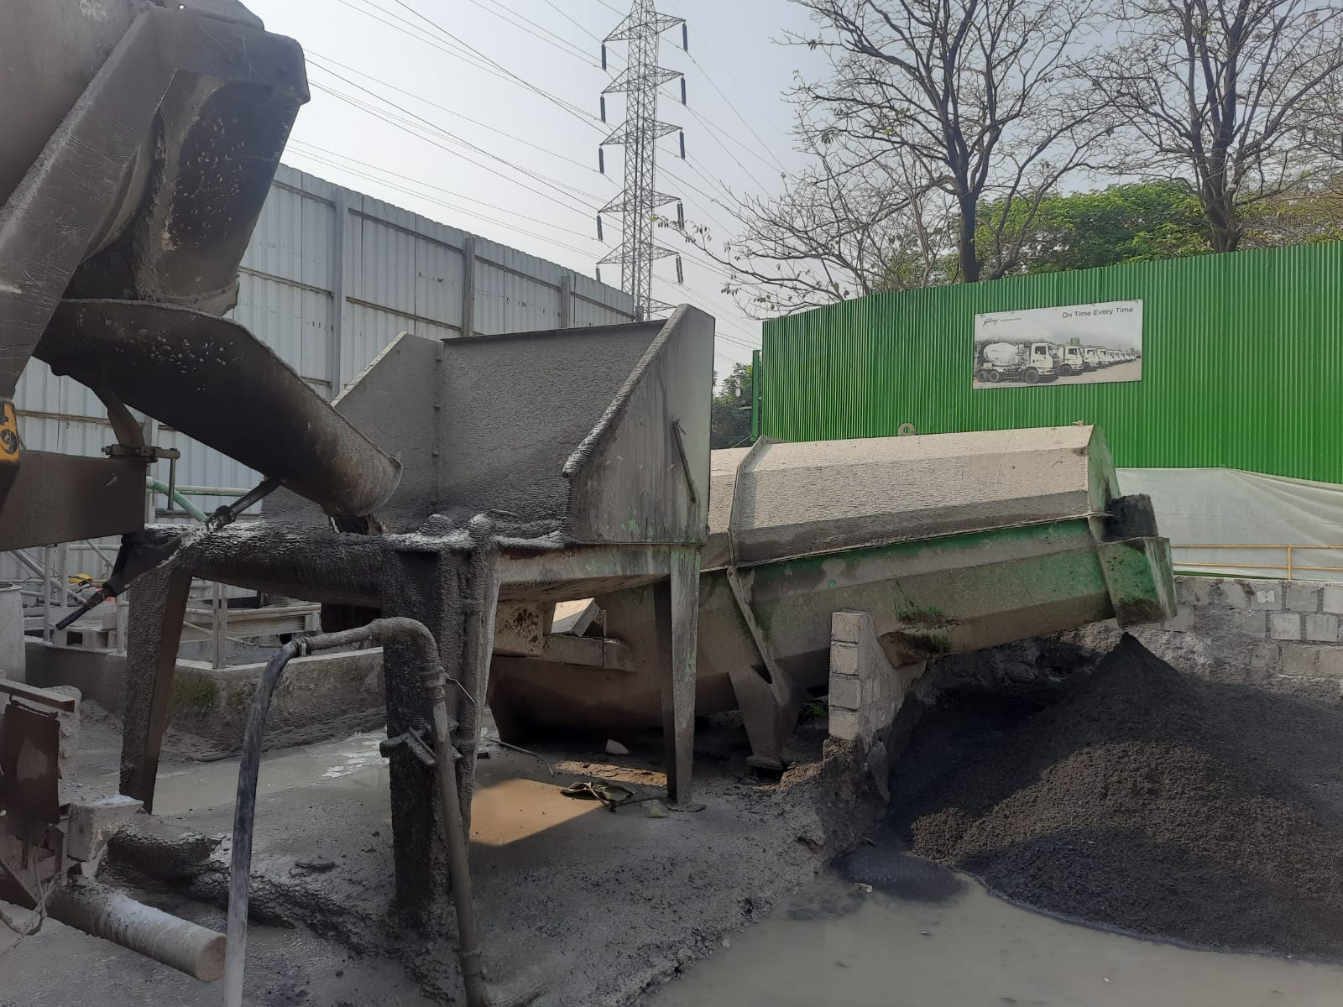
Provision of Sedimentation Tanks
An Adequate capacity Collection cum Settling tank has been provided to collect the water from Transit Mixer (TM) & Tyre washing
The supernatant water is reused for TM/Tyre washing/Water Sprinkling.

Slide 11
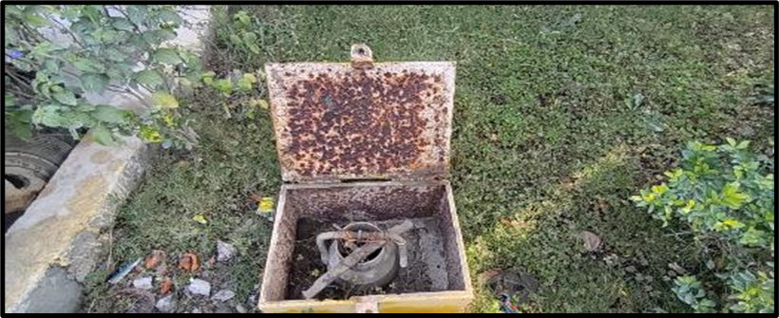
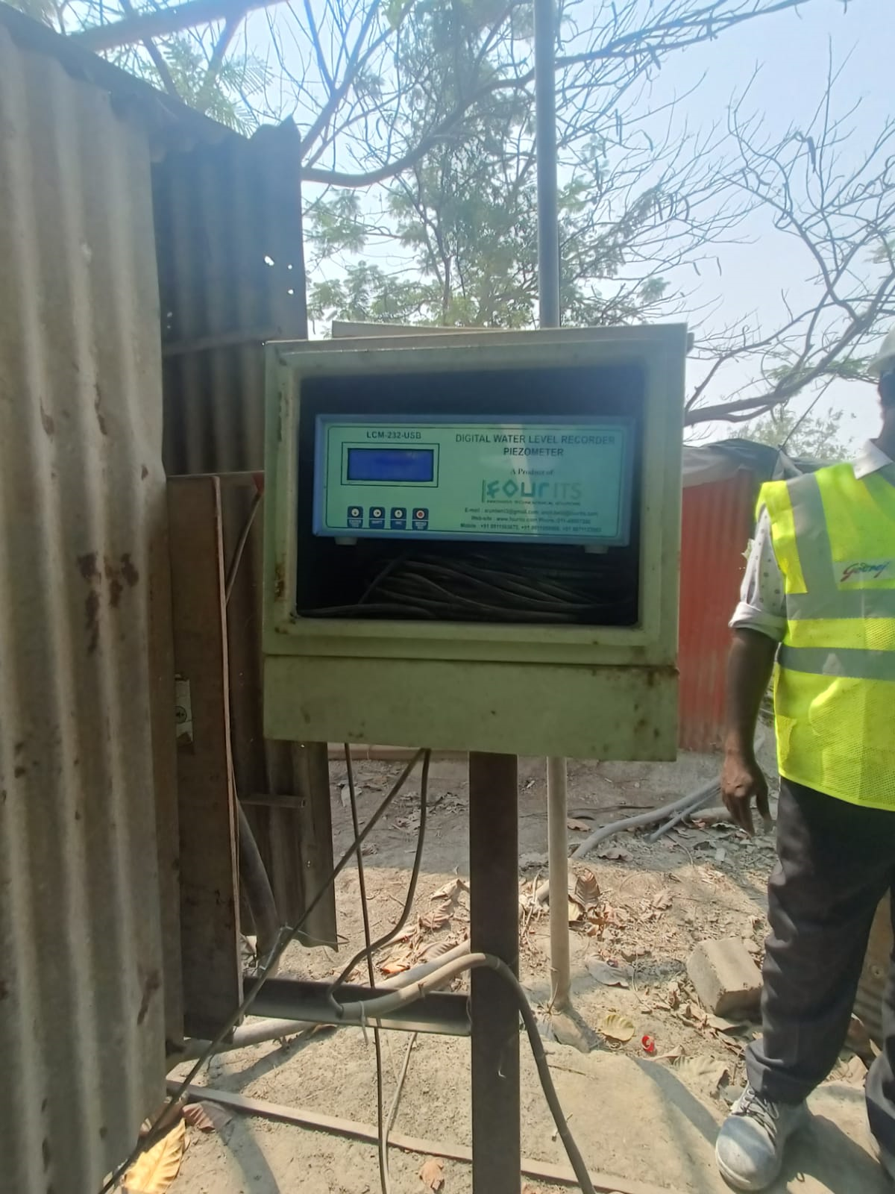
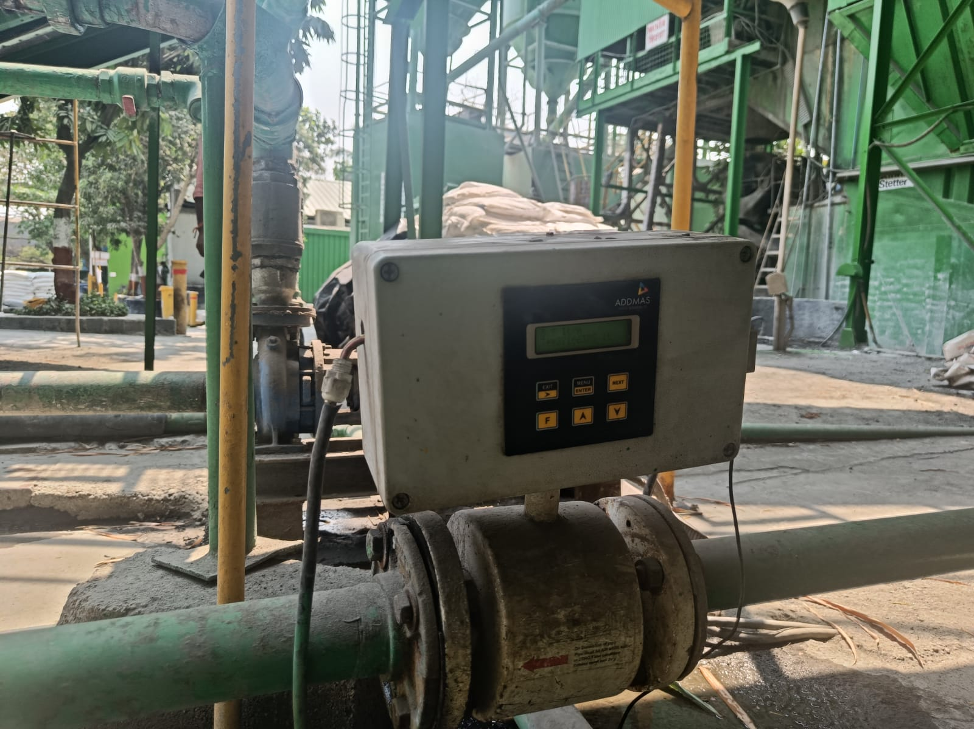
Compliance towards CGWA NOC
Borewell is maintained in good condition.
Digital flow meter is provided.
Piezometer is provided to track the water withdrawal of groundwater.

Slide 12
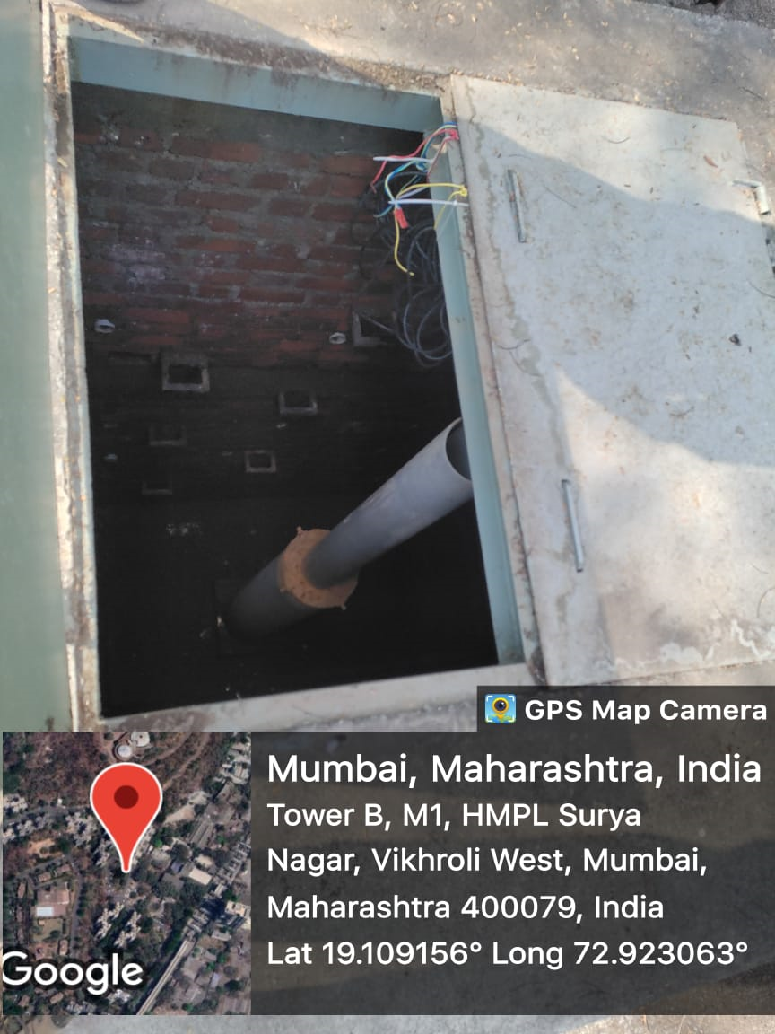
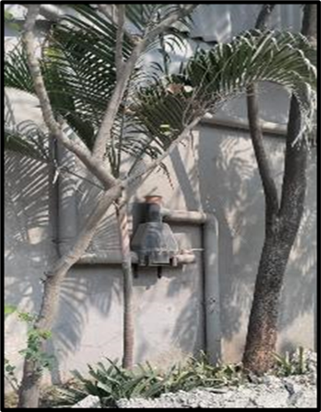
Rainwater Harvesting
Rainwater Harvesting System is provided.

Slide 13
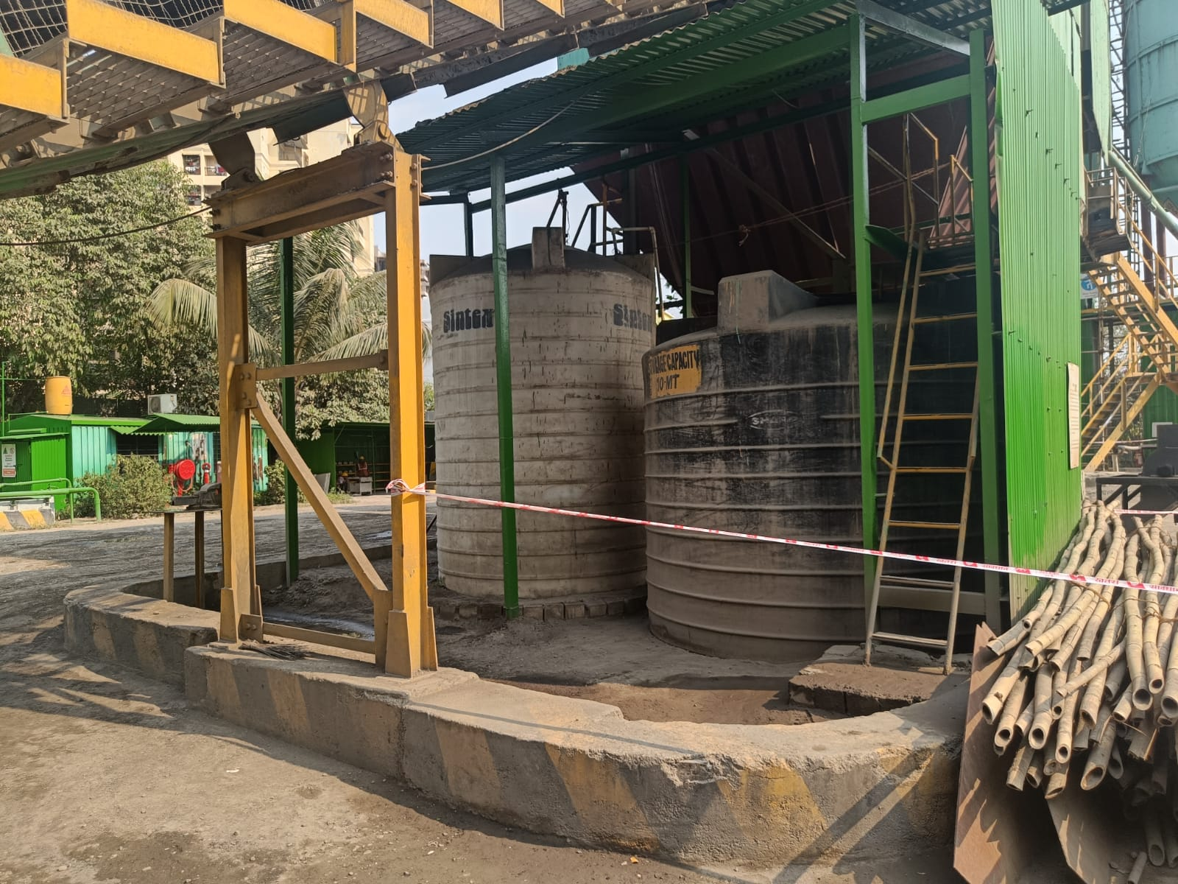
Secondary Containment System
Secondary Containment System has been provided for the Admixture Storage Drums.

Slide 14
Thank you

